Slide 1
Machine Bias
Saarang Ahuja

Slide 2
Hypothesis
Null Hypothesis: The data collected is biased towards white individuals (and is against black individuals)
Alternative Hypothesis: The data collected is unbiased towards white individuals (and is treating black individuals fairly)

Slide 3
Exploratory Data Analysis
A few things I took care of before further analysis…
A list of columns I deleted for producing visualizations:
'AssessmentID’, 'Case_ID’, 'LastName', 'FirstName', 'MiddleName’, 'IsCompleted', 'IsDeleted’, 'ScaleSet_ID’
Changed ‘African-Am’ to ‘African-American’ in the Ethnic column
Only 45 values of missing data, which were in ‘ScoreText’ column.
Models attempted: KNN, Clustering (K-Means), and Regression

Slide 4


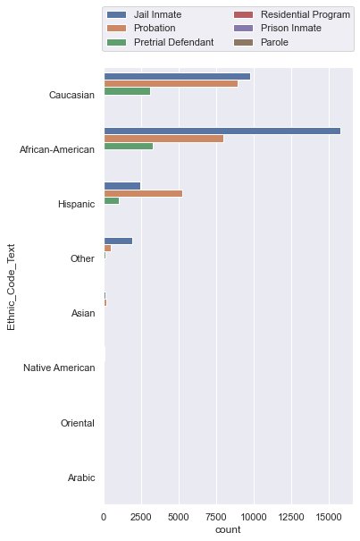

Custody Status as per Ethnicity
Top 3 Ethnicities in custody: Caucasian, African-American
Hispanic.
It seems more African-Americans are sentenced to being jail inmates than any other Ethnicity

Slide 5
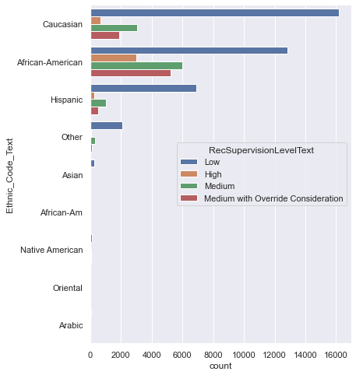
Supervision Level as per Ethnicity
It appears more Caucasians, than any other ethnicity, have the lowest supervision level
African-Americans have the highest occurences of ‘High’ and ‘Medium with Override Consideration’ supervision levels

Slide 6
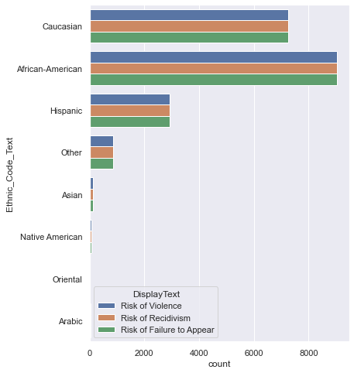
Ethnicity Frequency as per Risk
Regardless of what risk, African-Americans are recorded as the most risky.

Slide 7
Possible Bias in Gender
Sex | Female | Male
Ethnicity
African-American | 5583 | 21486
Arabic | 3 | 72
Asian | 57 | 267
Caucasian | 5433 | 16350
Hispanic | 1731 | 7011
Native American | 60 | 159
Oriental | 9 | 30
Other | 453 | 2139
Within each Ethnicity, there seems to be a
selection bias with picking more Males.
Difference in sample sizes between males and
females are significant.

Slide 8
Improvement?
Better Sampling
 | Ethnicity | Counts
0 | African-American | 27069
1 | Arabic | 75
2 | Asian | 324
3 | Caucasian | 21783
4 | Hispanic | 8742
5 | Native American | 219
6 | Oriental | 39
7 | Other | 2592
Though it seems African-Americans are being punished the most, it could be because the sample population consists of more African-Americans
It appears there is a selection bias as the sampling of criminals are mostly focused on Caucasians and African-Americans.

Slide 9
Logistic Regression Model
I use Logistic Regression as it is usually used to predict a categorical variable (Ethnicity in this case)
Regardless of the reason for selecting this specific model, the prediction accuracy was only 51%.

Slide 10
Self-Reflection
Run different kinds of machine learning algorithms that might be applicable to the study. For example, in this case, a Linear Regression could have also worked.
Having a more specific hypothesis to work on might return a higher prediction accuracy

